Slide 1
DETECTING FRAUD APPS USING
SENTIMENTAL ANALYSIS
Submitted in the partial fulfillment for the award of the degree of
BACHELOR OF ENGINEERING
IN
BIG DATA ANALYTICS
Submitted by:
Shubhanshu(21BCS3854)
Sulekha (21BCS9641)
Shameem Ahmad (21BCS3807)
Adit Kulshreshtha (21BCS3703)
Under the Supervision of:
Ms. Amanpreet Kaur
Department of AIT-CSE
DISCOVER . LEARN . EMPOWER

Slide 2
Outline
Introduction to Project
Problem Formulation
Objectives of the work
Methodology used
Results and Outputs
Conclusion
Future Scope
References

Slide 3
Introduction
There are many apps on the internet that look and function similarly to the original app, but they are fake. So, the users who use fake apps have faced issues after installing the app. That app harms their devices and extracts some personal information about the user. So, the reviews of the original app are decreasing because so many apps are now banned because of data leaks. So, to overcome this problem, we are using sentiment analysis to detect the fraud apps that are present in the internet world. The use of mobile phones is increasing as technology advances. The creation of various mobile apps on various systems, such as the famous Android and iOS, has increased dramatically. Because of its rapid increase in daily utilisation, sales, and developments, it has become a major task in the world of business intelligence. This increases industry rivalry. Companies and application developers are competing fiercely with one another in order to demonstrate the quality of their products and devote significant resources to drawing consumers in order to maintain their future progress.

Slide 4
Problem Formulation
The security and privacy of users are maintained in large part by spotting fraudulent programmed in app stores. By the examination of user ratings and feedback, sentiment analysis may be used to spot fake programmed.
The following is a description of the issue formulation for sentiment analysis-based fraud detection apps. The objective is to create a machine learning model that can precisely divide app reviews into two groups, authentic and fraudulent, using a dataset of app evaluations.
A labelled dataset of reviews, where each review is classified as either valid or fraudulent, should be used to train the model. The content of the reviews should be analyzed by the sentiment analysis model to identify characteristics that may be utilized to distinguish between honest and dishonest evaluations.

Slide 5
Objectives of the Work
The goal of sentiment analysis fraud detection research is to create an automated system that can correctly identify counterfeit programmed in app stores. The following sub-objectives can be further divided into this main goals.
Provide a thorough collection of app reviews, including both real and fraudulent ratings. This dataset should include many reviews for many apps. The dataset need to be reflective of the kinds of app store evaluations that are commonly available.
Software used in fake mobile applications imitates features of real, trustworthy, and legitimate applications. These applications perform malicious deeds as soon as they are launched, such as actively show advertisements to generate income, intercept private data from your system, infect devices, and more.

Slide 6
Methodology
Our paper's major goal is to present a strategy for extracting useful data from mobile applications based on user reviews, ratings, and ranking, and aggregating this evidence to find applications that are fraudulent.
Our algorithm will make use of each user review and rating in order to determine how each user feels about the subject. The gathering of data is crucial to machine learning. The process of acquiring and analyzing data from various sources is known as data collection.
In order for machine learning to more precisely identify some input parameters, it needs a large amount of data with many features. The crucial component that enables algorithm training is data collecting. A higher number of qualities has been shown to produce better results.

Slide 7
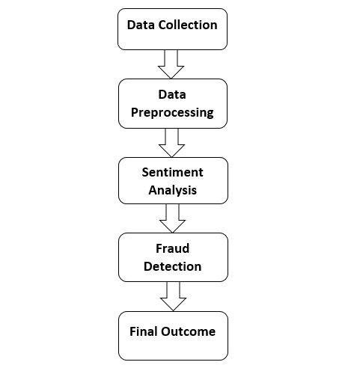

Slide 8
Results and Outputs
When we collect dataset by using library app-scraper to get reviews from the any app. We are taking app from the Appstore and the we take its id, country, and app name from the Appstore to fetch the reviews of that app. Then we convert the dataset of reviews into the csv file.
After that we use nltk (Natural Language Toolkit) to do sentimental analysis and then we use VADER (Valence Aware Dictionary and Sentiment Reasoner) is a lexicon and rule-based sentiment analysis tool that is tuned in to social media sentiments.
VADER employs a mix of A sentiment lexicon is a collection of lexical characteristics (e.g., words) that are labelled as positive or negative based on their semantic orientation. VADER not only reports the Positivity and Negativity scores, but also how positive or negative an emotion is.
After that we check the polarity scores of each review which is in the csv file then we check that is reviews are positive, negative, or neutral by using the polarity scores. Then print the sentiment analysis details of each review.

Slide 9
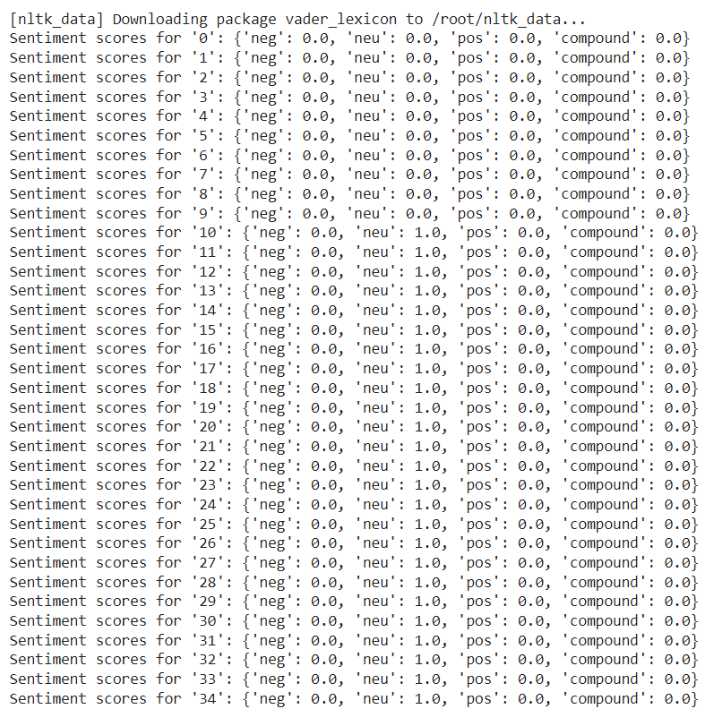
POLARITY SCORE’S

Slide 10
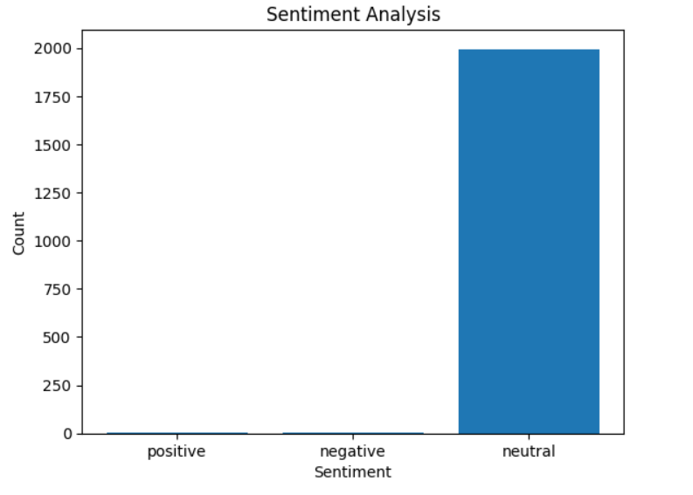
Analysis Of The Dataset

Slide 11
Conclusion
Sentiment analysis is a powerful tool for detecting fraud apps. It is fast, accurate, and cost-effective, making it an attractive option for businesses looking to protect their users from malicious applications. However, sentiment analysis is not perfect and has some limitations that should be taken into consideration.
Overall, sentiment analysis is a useful tool for detecting fraud apps. With the right implementation, it can be used to protect users from malicious applications and keep their personal information and financial data safe. Using sentiment analysis, this article developed a thorough framework for spotting fraudulent applications.
This methodology provides a proactive and automated strategy to identifying possible signs of fraudulent behavior by employing machine learning algorithms and analyzing user reviews and comments.

Slide 12
Future Scope
Relevant characteristics, such as the sentiment of the review, the frequency of particular words or phrases, the length of the review, and the language employed, are extracted from the preprocessed data using sentiment analysis algorithms.
Overall, the experimental setup for using sentiment analysis to identify fraud apps entails gathering and preprocessing data, extracting features, training.
Evaluating a machine learning model, comparing with other approaches, interpreting the outcomes, and reporting the findings in a technical report or scientific paper.

Slide 13
References
1. Safrin, Raheesa, K. R. Sharmila, TS Shri Subangi, and E. A. Vimal. "Sentiment analysis on online product review." Int. Res. J. Eng. Technol 4, no. 04(2017).
2. Shahana, P. H., and Bini Omman. "Evaluation of features on sentimental analysis." Procedia Computer Science 46 (2015): 15851592.
3. “Muhammad Taimoor Khan, Mehr Durrani, Armughan Ali, Irum Inayat, Shehzad Khalid & Kamran Habib Khan “Sentiment analysis and complex natural language” (2016) a springeropen journal
4. Narayanan, Ramanathan, Bing Liu, and Alok Choudhary. "Sentiment analysis of conditional sentences." In Proceedings of the 2009 Conference on
Empirical Methods in Natural Language Processing: Volume 1-Volume 1, pp. 180-189. Association for Computational Linguistics, 2009.

